Slide 1
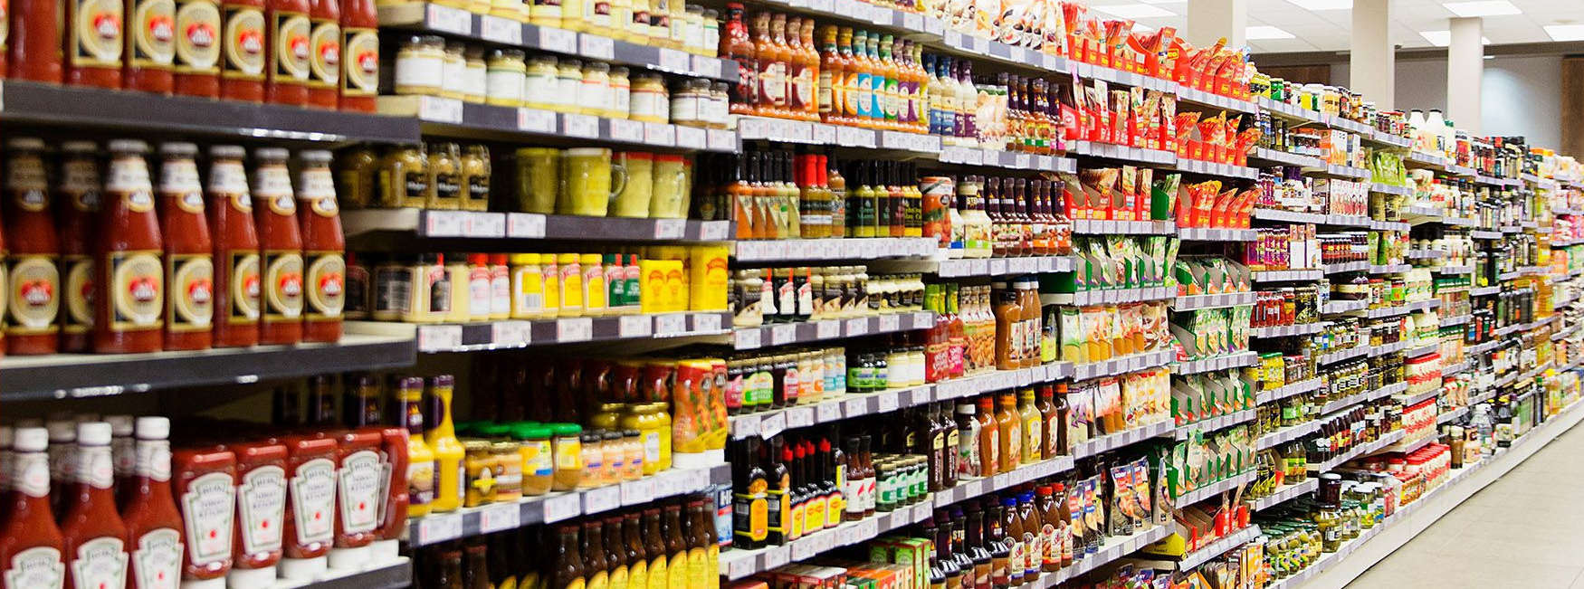
Food deserts’ impact on covid-19 metrics in chicago
By Manli Patel, Jen Krizman, and Roxanne Meyer

Slide 2
Does grocery store availability impact covid-19 outcomes in Chicago?
While there are many compounding factors as to why specific zip codes had higher Covid-19 infection rates, we wanted to analyze if the amount of grocery stores was correlated to these outcome. We hypothesized that grocery stores, in part, have a positive impact on a zip codes’ health, which has showed to impact a populations’ COVID-19 outcome. Additionally, grocery stores have the ability to administer COVID-19 vaccinations, boosters and tests, which could positively affect a zip codes’ COVID-19 infection rates.

Slide 3
DATA Sources
US Census for Chicago (API)
City of Chicago Data Portal
Grocery Store Status
COVID-19 Hospitalizations and Deaths

Slide 4
Hypothesis 1
Within Chicago Zip Codes, zip codes with higher than average household income will have more grocery stores than zip codes with lower than average household income
Rationale: Businesses are more likely to build in areas where individuals have more disposable income to spend on their products and services

Slide 5
Hypothesis 1 Data
Scatter plot
X: median household income of the zip code
Y: number of grocery stores in that zip code

Slide 6
Hypothesis 1 Data(cont.)
Scatter plot
X: median household income of the zip code
Y: number of grocery stores in that zip code
Regression line and r value

Slide 7
Hypothesis 2
Within Chicago Zip Codes, lower income areas will have higher rates of COVID-19 than higher income areas
Rationale: Lower Income areas have several contributing factors leading to these higher rates:
Less access to healthcare
Lowered ability to afford healthcare which may mitigate COVID-19 transmission

Slide 8
Hypothesis 2 Data
Double Scatter plot
X: median household income of the zip code
Y: two plots, one for covid 19 hospitalizations, and one for covid 19 deaths
Regression line and r value

Slide 9
Hypothesis 2 Data(cont.)

Slide 10
Hypothesis 3
Within Chicago Zip Codes,
Rationale:

Slide 11
Hypothesis 3 Data

Slide 12
Hypothesis 3 Data(cont.)

Slide 13
Conclusions
Hypothesis 1:
Hypothesis 2:
Hypothesis 3:

Slide 14
Implications of the analysis

